Slide 1
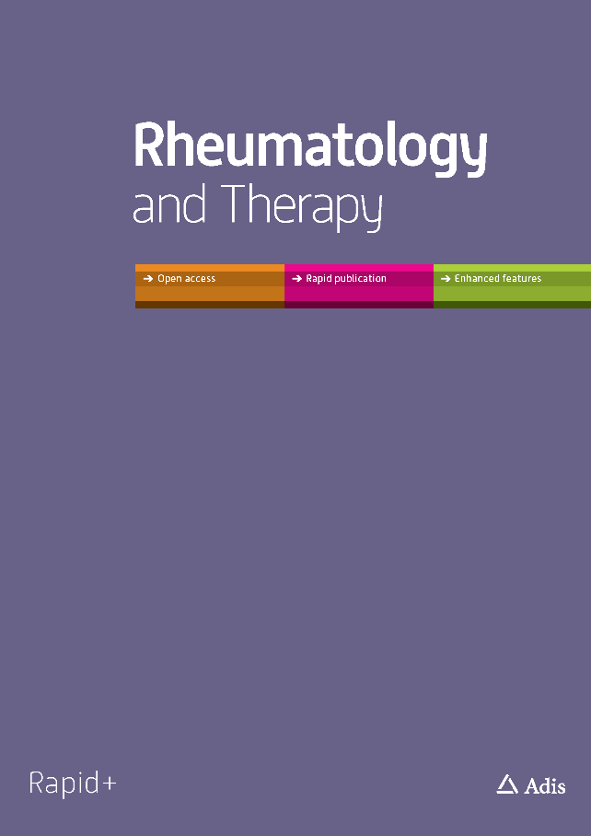
PEER-REVIEWED SLIDE DECK
Monov, S. et al. Persistence with Denosumab in Women at High Risk of Fracture in Bulgaria. Rheumatol Ther. 2021. 10.1007/s40744-021-00282-3
This slide deck represents the opinions of the authors. For a full list of declarations, including funding and author disclosure statements, please see the full text online.
© The authors, CC-BY-NC 2021.
Persistence with Denosumab in Women at High Risk of Fracture in Bulgaria
Monov, S. et al. Rheumatol Ther. 2021. 10.1007/s40744-021-00282-3

Slide 2
PEER-REVIEWED SLIDE DECK
Introduction
Osteoporosis is a well-characterized public health problem that is growing with the aging population in Europe [1].
Available treatments for osteoporosis include oral bisphosphonates and Denosumab.
Denosumab is a Rank Ligand inhibitor administered via subcutaneous injection once every 6 months, and is associated with high medication persistence [10].
Our study estimated persistence (defined as no more than a 60-day gap between injections) with denosumab at 12, 18 and 24 months in clinical practice in Bulgaria.
[1] Hernlund E, Svedbom A, Ivergard M, Compston J, Cooper C, Stenmark J, et al. Osteoporosis in the European Union: medical management, epidemiology and economic burden. A report prepared in collaboration with the International Osteoporosis Foundation (IOF) and the European Federation of Pharmaceutical Industry Associations (EFPIA). Arch Osteoporos. 2013;8:136.
[10] Jonsson E, Cheng LI, Strom O, Intorcia M, Karlsson L. Systematic Review and Meta-Analysis of Persistence With Denosumab in Patients With Osteoporosis. Value Health. 2014;17(7):A383-4.
Persistence with Denosumab in Women at High Risk of Fracture in Bulgaria
Monov, S. et al. Rheumatol Ther. 2021. 10.1007/s40744-021-00282-3

Slide 3
PEER-REVIEWED SLIDE DECK
Methods
This multicenter, retrospective/prospective, observational study was conducted at 12 sites in Bulgaria.
The eligibility criteria were:
women >70 years of age.
diagnosed with osteoporosis by dual X-ray absorptiometry scan (T-score at the lumbar spine, femoral neck or total hip ≤ -2.5).
received at least one injection of denosumab prior to the approval of the protocol.
met FRAX® criteria for high fracture risk (≥ 3% risk for hip fracture or ≥20% risk for major osteoporotic fracture).
had not participated in clinical or medical device trials in the last six months, and were not receiving any other osteoporosis therapy.
Study sites were selected based on their interest in participation and their ability to enroll at least ten patients. Geographic distribution and balance between academic and private practice settings were also considered.
Persistence with Denosumab in Women at High Risk of Fracture in Bulgaria
Monov, S. et al. Rheumatol Ther. 2021. 10.1007/s40744-021-00282-3

Slide 4
PEER-REVIEWED SLIDE DECK
Baseline data were collected retrospectively from medical records over a period of up to six months.
Outcomes data were collected prospectively for 24 months from the date of first denosumab injection; measurements after 24 months, where available, were also collected.
Statistical Considerations
Kaplan-Meier methodology was used to estimate the proportion of patients (95% confidence interval (CI)persistent with denosumab at 12, 18, and 24 months.
The number of days a patient had been persistent to denosumab treatment was estimated with discontinuation considered as a failure event.
Sensitivity analyses for the primary outcome included persistence estimates for 30-day and 90-day gaps between injections.
Post hoc statistical comparisons of gap length were performed using the chi-squared test.
Persistence with Denosumab in Women at High Risk of Fracture in Bulgaria
Monov, S. et al. Rheumatol Ther. 2021. 10.1007/s40744-021-00282-3

Slide 5
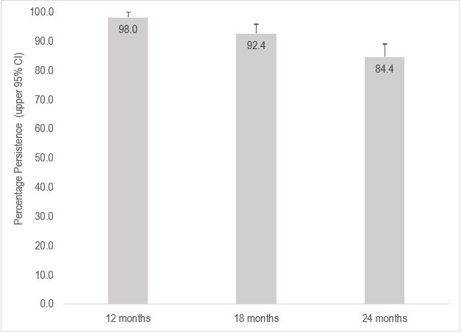
PEER-REVIEWED SLIDE DECK
Results
250 women were enrolled across 12 Bulgarian endocrinology/rheumatology practices; median follow up, 736 days.
Mean (SD) age was 75.8 (4.2) years; mean (SD) FRAX® was 13.1 (8.6) for hip and 26.1 (9.5) for major osteoporotic fracture; 47 (18.8%) women had prior osteoporosis therapy and 104 (41.6%) had prior fracture.
Most patients (82.8%) received all five scheduled denosumab injections during the study.
Figure 1. Kaplan-Meier Estimated Probability with Upper 95% CI of Persistence with Denosumab at 12, 18, and 24 Months for Medication Refill Gaps of 60 Days (Primary Endpoint)
Persistence with Denosumab in Women at High Risk of Fracture in Bulgaria
Monov, S. et al. Rheumatol Ther. 2021. 10.1007/s40744-021-00282-3

Slide 6
PEER-REVIEWED SLIDE DECK
Discussion
The main reasons for non-persistence were discontinuation (for financial reasons) and a treatment delay.
It appears that this group of retired women (median age 75) on a pension faced difficulty affording the 50% co-payment required for osteoporosis medications in Bulgaria.
The process of prescribing osteoporosis treatment in Bulgaria is complicated. While specialists are required to diagnose must complete osteoporosis, general practitioners the reimbursement fund prescription. This procedure requires patients to navigate a long process which likely leads to longer gap times.
Persistence with Denosumab in Women at High Risk of Fracture in Bulgaria
Monov, S. et al. Rheumatol Ther. 2021. 10.1007/s40744-021-00282-3

Slide 7
PEER-REVIEWED SLIDE DECK
Conclusion
A high rate of persistence to denosumab was observed in Bulgarian clinical practice, with 84% of women remaining on treatment at 24 months.
After 24 months, 42.4%, 23.6% and 49.2% of patients achieved osteopenia at the femoral neck, lumbar spine and total hip.
Improvements in bone mineral density (BMD) T-score at all locations along with a notable proportion of patients achieving osteopenia or recovery suggest that denosumab is effective in treating patients at high risk of fracture in clinical practice.
Persistence with Denosumab in Women at High Risk of Fracture in Bulgaria
Monov, S. et al. Rheumatol Ther. 2021. 10.1007/s40744-021-00282-3

